Slide 1
Is NIL fairly compensating top-level college athletes?
Ben Quick & Austin Liu

Slide 2
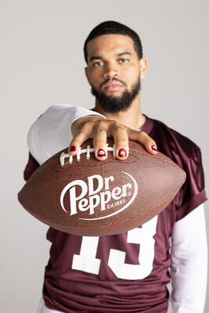
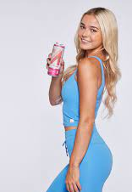
What is NIL?
Name
Image
Likeness

Slide 3
The creating and posting of content accounts for 43.7% of all NIL Compensation

Slide 4
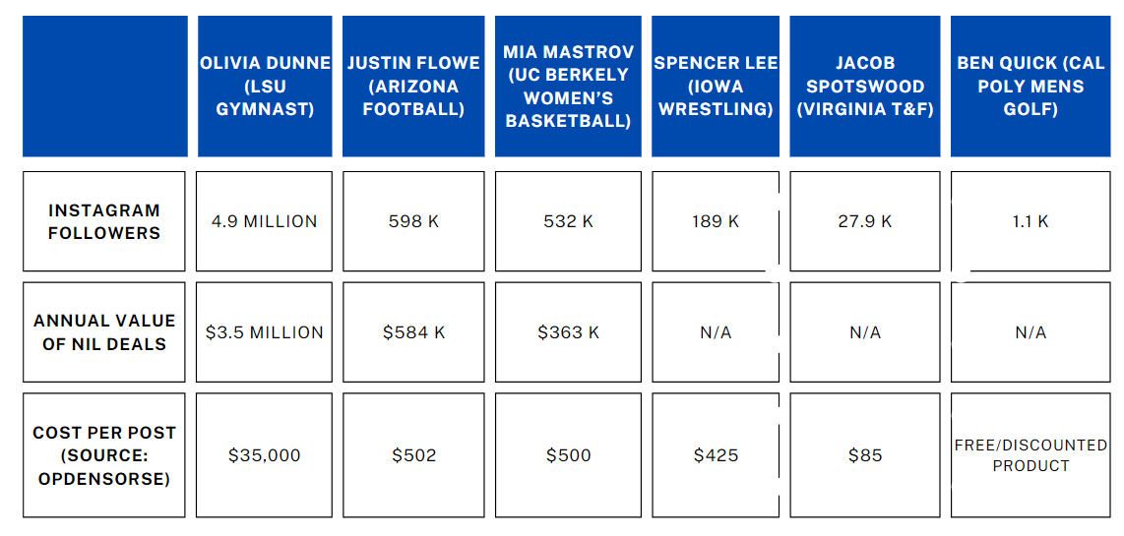
NIL Athletes and What they are Charging…

Slide 5
Is this fair compensation?

Slide 6
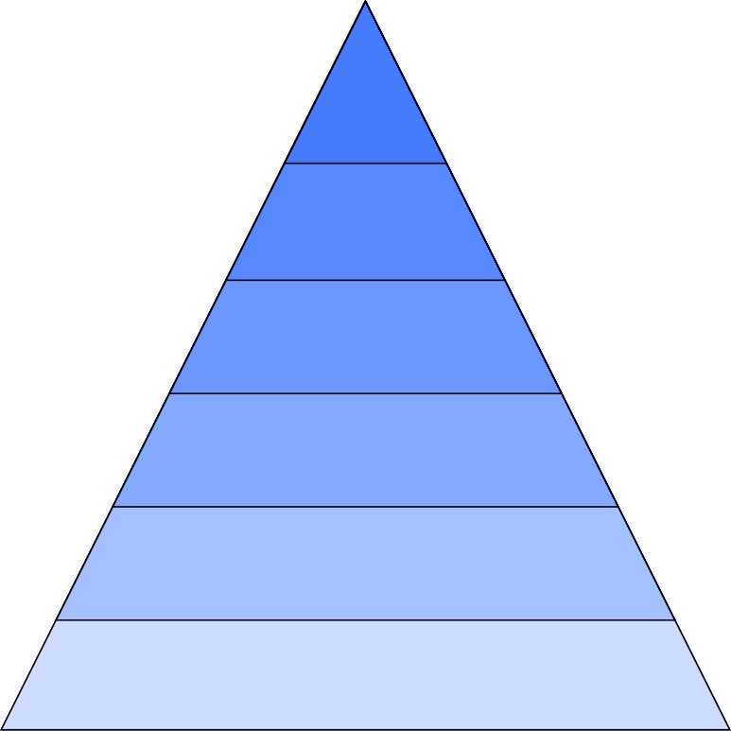
Influencer Classification by Follower Count
Mega (1 Million +)
Macro (500k - 1 Million)
Mid-tier (50k - 500k)
Micro (10k - 50k)
Nano (1k - 10k)
Other (<1k)

Slide 7
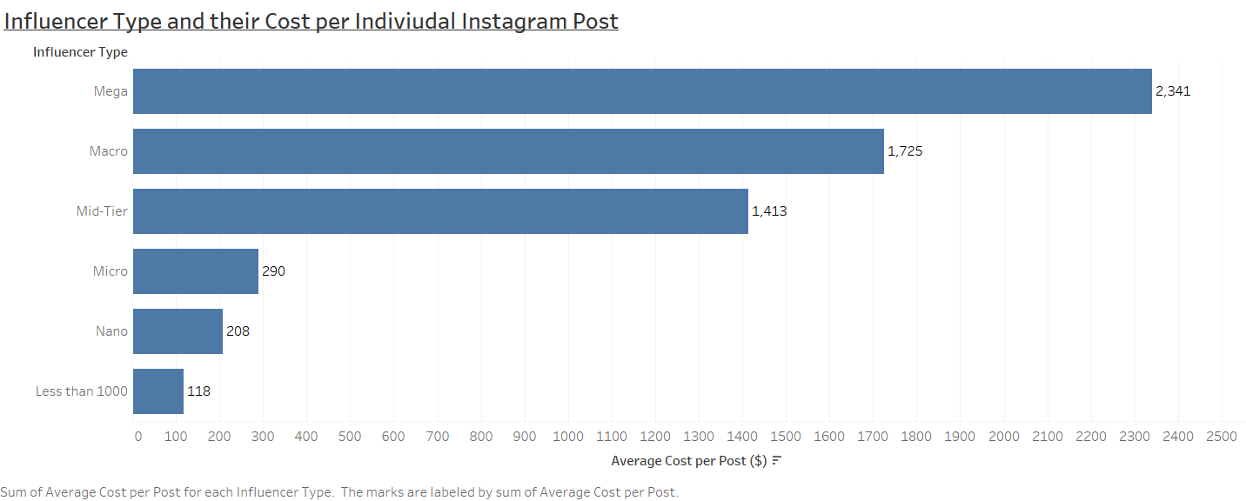
How much are influencers charging for instagram posts?
Source: Collabstr Influencer Marketplace

Slide 8
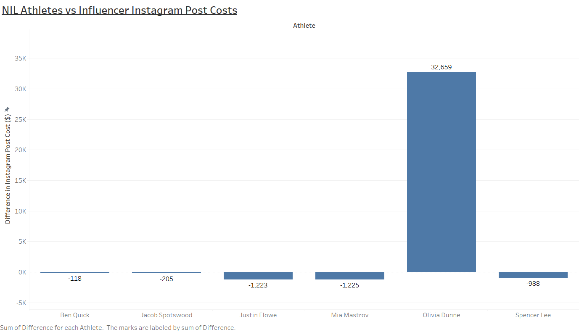
NIL Athletes vs Regular Influencers
Mega Influencer
Nano Influencer
Micro Influencer
Macro Influencer
Macro Influencer
Mid-Tier Influencer

Slide 9
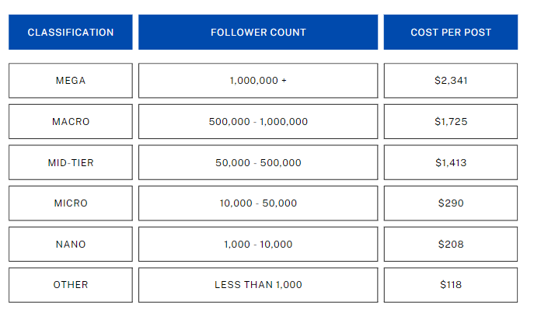
Recommendation

